Slide 1
DESIGN PATTERNS

Slide 2

DESIGN PATTERNS
Pattern:
a particular way in which something is done, is organized, or happens.
Design pattern:
Design patterns are used to represent some of the best practices adapted by experienced object-oriented software developers.
Design patterns are typical solutions to common problems in software design. Each pattern is like a blueprint that you can customize to solve a particular design problem in your code.
COMPILATION
(javac.exe)
RUNTIME
CONFIDENTIAL
4

Slide 3
GANG OF FOUR
COMPILATION
(javac.exe)
RUNTIME
In 1994, four authors Erich Gamma, Richard Helm, Ralph Johnson and John Vlissides published a book titled Design Patterns - Elements of Reusable Object-Oriented Software which initiated the concept of Design Pattern in Software development.
These authors are collectively known as Gang of Four (GOF). According to these authors design patterns are primarily based on the following principles of object orientated design.
Program to an interface not an implementation
Favor object composition over inheritance
CONFIDENTIAL
4

Slide 4
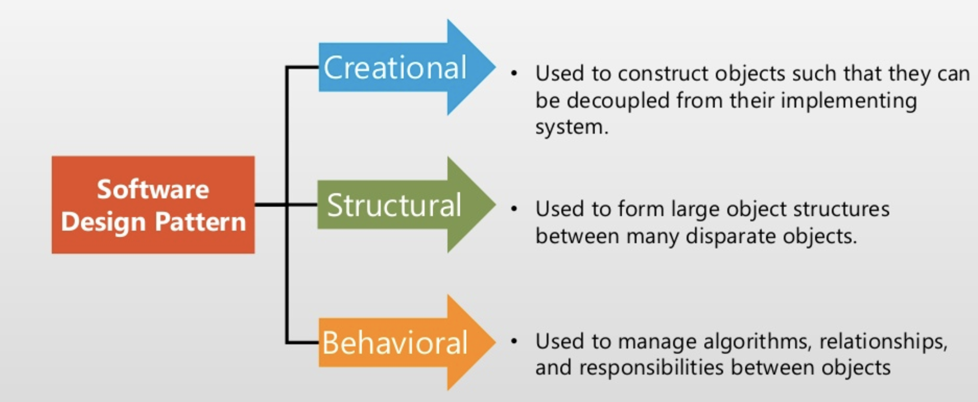
TYPES OF DESIGN PATTERNS
COMPILATION
(javac.exe)
RUNTIME
CONFIDENTIAL
4

Slide 5
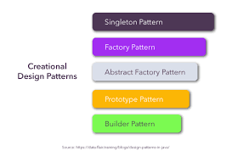
CREATIONAL DESIGN PATTERN
COMPILATION
(javac.exe)
RUNTIME
Creational design patterns are concerned with the way of creating objects. These design patterns are used when a decision must be made at the time of instantiation of a class (i.e. creating an object of a class).
We have 5 types of creational design patterns.
CONFIDENTIAL
4

Slide 6
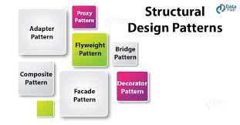
STRUCTURAL DESIGN PATTERN
COMPILATION
(javac.exe)
RUNTIME
Structural design patterns are concerned with how classes and objects can be composed, to form larger structures.
The structural design patterns simplifies the structure by identifying the relationships.
These patterns focus on, how the classes inherit from each other and how they are composed from other classes.
They are divided into 7 types.
CONFIDENTIAL
4

Slide 7
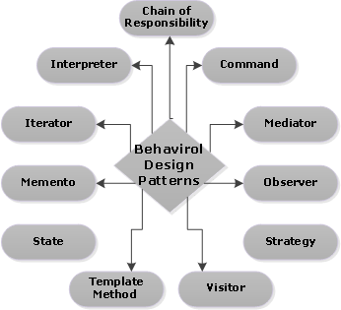
BEHAVIORAL DESIGN PATTERN
COMPILATION
(javac.exe)
RUNTIME
Behavioral design patterns are concerned with the interaction and responsibility of objects.
In these design patterns, the interaction between the objects should be in such a way that they can easily talk to each other and still should be loosely coupled.
That means the implementation and the client should be loosely coupled in order to avoid hard coding and dependencies.
CONFIDENTIAL
4

Slide 8
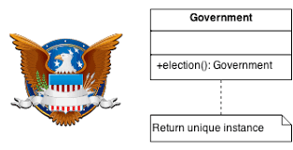
SINGLETON PATTERN
COMPILATION
(javac.exe)
RUNTIME
Singleton is a creational design pattern that lets you ensure that a class has only one instance, while providing a global access point to this instance.
CONFIDENTIAL
4

Slide 9
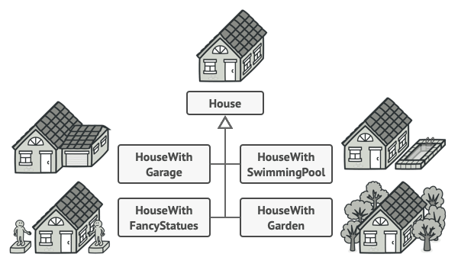
BUILDER PATTERN
COMPILATION
(javac.exe)
RUNTIME
Builder pattern builds a complex object using simple objects and using a step by step approach.
CONFIDENTIAL
4

Slide 10
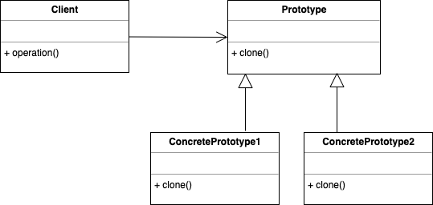
PROTOTYPE PATTERN
COMPILATION
(javac.exe)
RUNTIME
Prototype allows us to hide the complexity of making new instances from the client. The concept is to copy an existing object rather than creating a new instance from scratch, something that may include costly operations. The existing object acts as a prototype and contains the state of the object.
The newly copied object may change same properties only if required. This approach saves costly resources and time, especially when the object creation is a heavy process.
CONFIDENTIAL
4

Slide 11
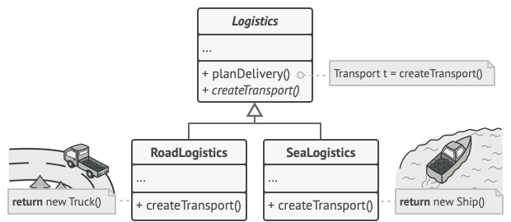
FACTORY PATTERN
COMPILATION
(javac.exe)
RUNTIME
Factory Method is a creational design pattern that provides an interface for creating objects in a superclass, but allows subclasses to alter the type of objects that will be created.
CONFIDENTIAL
4

Slide 12
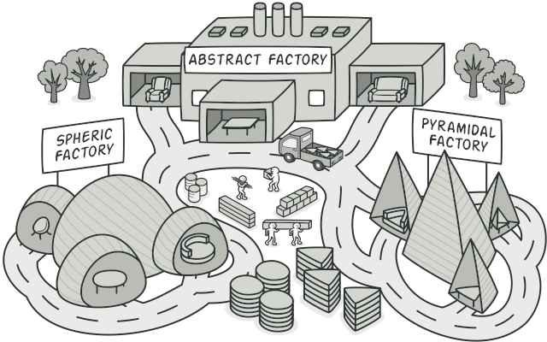
ABSTRACT FACTORY PATTERN
COMPILATION
(javac.exe)
RUNTIME
Abstract Factory is a creational design pattern that lets you produce families of related objects without specifying their concrete classes.
CONFIDENTIAL
4

Slide 13
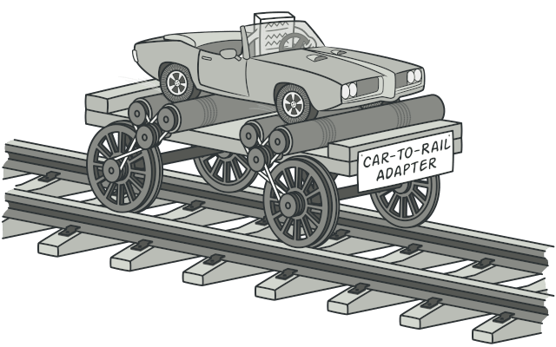
ADAPTER PATTERN
COMPILATION
(javac.exe)
RUNTIME
Adapter is a structural design pattern that allows objects with incompatible interfaces to collaborate.
CONFIDENTIAL
4

Slide 14
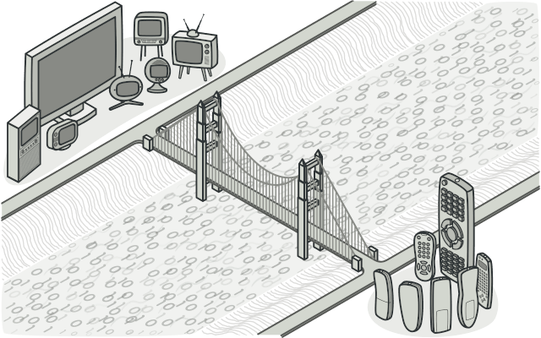
BRIDGE PATTERN
COMPILATION
(javac.exe)
RUNTIME
Bridge is a structural design pattern that lets you split a large class or a set of closely related classes into two separate hierarchies—abstraction and implementation—which can be developed independently of each other.
CONFIDENTIAL
4

Slide 15
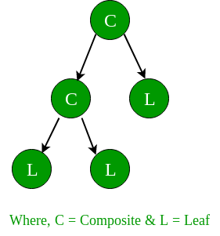
COMPOSITE PATTERN
COMPILATION
(javac.exe)
RUNTIME
Composite is a structural design pattern that lets you compose objects into tree structures and then work with these structures as if they were individual objects.
CONFIDENTIAL
4

Slide 16
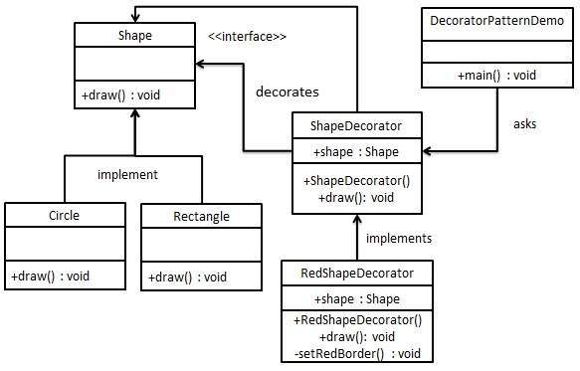
DECORATOR PATTERN
COMPILATION
(javac.exe)
RUNTIME
Decorator is a structural design pattern that lets you attach new behaviors to objects by placing these objects inside special wrapper objects that contain the behaviors.
CONFIDENTIAL
4

Slide 17
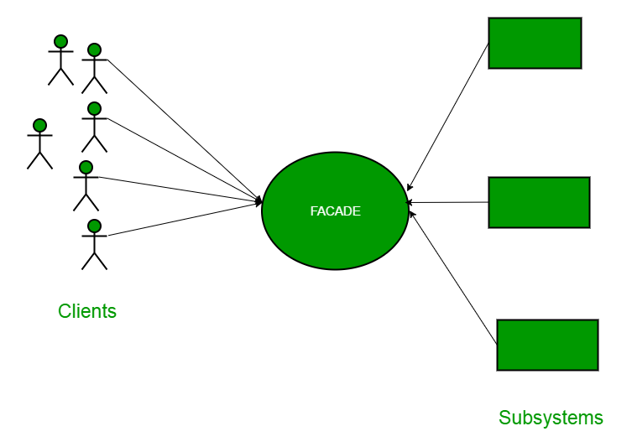
FACADE PATTERN
COMPILATION
(javac.exe)
RUNTIME
Facade is a structural design pattern that provides a simplified interface to a library, a framework, or any other complex set of classes.
CONFIDENTIAL
4

Slide 18
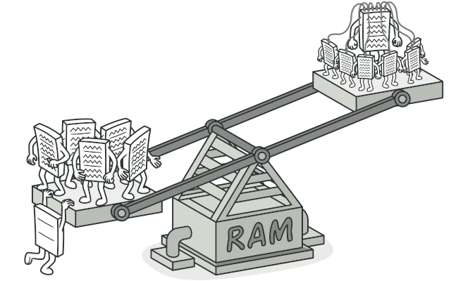
FLYWEIGHT PATTERN
COMPILATION
(javac.exe)
RUNTIME
Flyweight is a structural design pattern that lets you fit more objects into the available amount of RAM by sharing common parts of state between multiple objects instead of keeping all of the data in each object.
CONFIDENTIAL
4

Slide 19
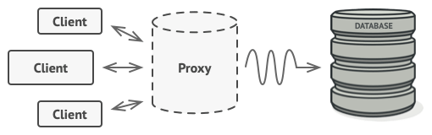
PROXY PATTERN
COMPILATION
(javac.exe)
RUNTIME
Proxy is a structural design pattern that lets you provide a substitute or placeholder for another object. A proxy controls access to the original object, allowing you to perform something either before or after the request gets through to the original object.
CONFIDENTIAL
4

Slide 20
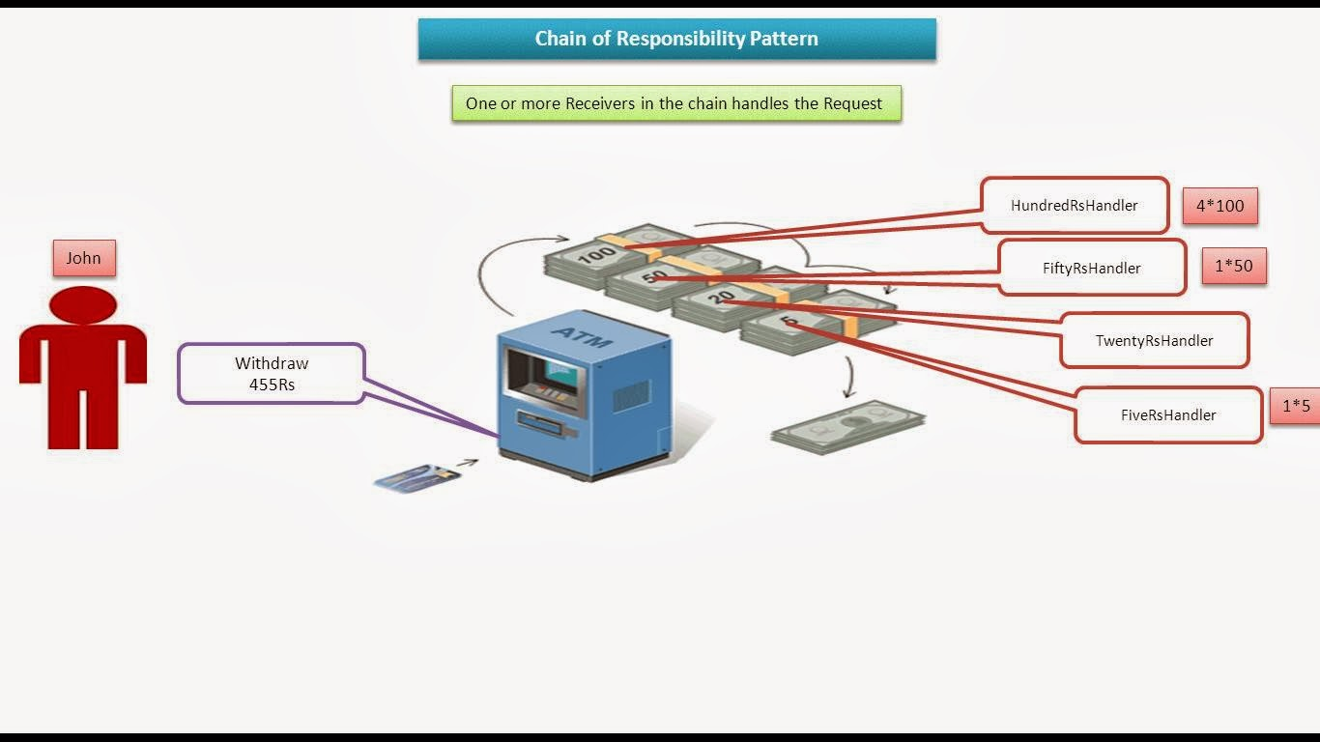
CHAIN OF RESPONSIBILITY PATTERN
COMPILATION
(javac.exe)
RUNTIME
Chain of Responsibility is a behavioral design pattern that lets you pass requests along a chain of handlers. Upon receiving a request, each handler decides either to process the request or to pass it to the next handler in the chain.
CONFIDENTIAL
4

Slide 21
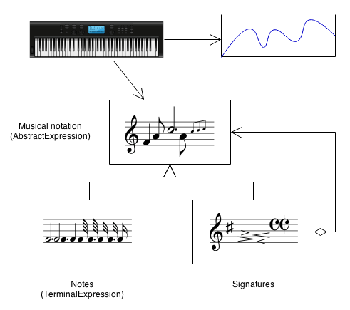
INTERPRETER PATTERN
COMPILATION
(javac.exe)
RUNTIME
Interpreter pattern provides a way to evaluate language grammar or expression. This pattern involves implementing an expression interface which tells to interpret a particular context. This pattern is used in SQL parsing, symbol processing engine etc.
CONFIDENTIAL
4

Slide 22
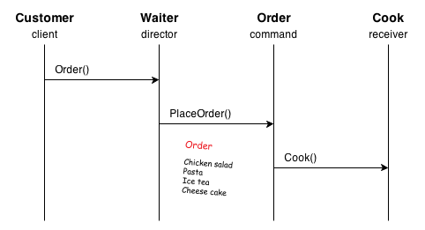
COMMAND PATTERN
COMPILATION
(javac.exe)
RUNTIME
A request is wrapped under an object as command and passed to invoker object. Invoker object looks for the appropriate object which can handle this command and passes the command to the corresponding object which executes the command.
CONFIDENTIAL
4

Slide 23
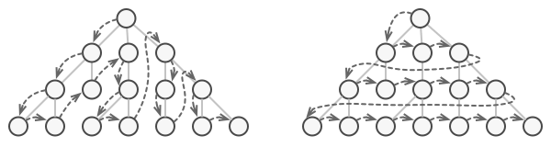
ITERATOR PATTERN
COMPILATION
(javac.exe)
RUNTIME
Iterator is a behavioral design pattern that lets you traverse elements of a collection without exposing its underlying representation (list, stack, tree, etc.).
CONFIDENTIAL
4

Slide 24

MEDIATOR PATTERN
COMPILATION
(javac.exe)
RUNTIME
Mediator is a behavioral design pattern that lets you reduce chaotic dependencies between objects. The pattern restricts direct communications between the objects and forces them to collaborate only via a mediator object.
CONFIDENTIAL
4

Slide 25

OBSERVER PATTERN
COMPILATION
(javac.exe)
RUNTIME
Observer is a behavioral design pattern that lets you define a subscription mechanism to notify multiple objects about any events that happen to the object they’re observing.
CONFIDENTIAL
4

Slide 26
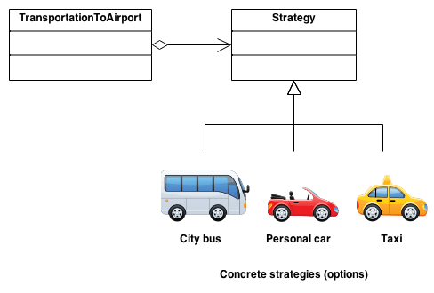
STRATEGY PATTERN
COMPILATION
(javac.exe)
RUNTIME
Strategy is a behavioral design pattern that lets you define a family of algorithms, put each of them into a separate class, and make their objects interchangeable.
CONFIDENTIAL
4

Slide 27
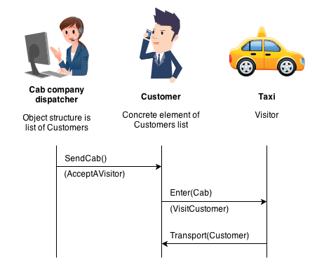
VISITOR PATTERN
COMPILATION
(javac.exe)
RUNTIME
Visitor is a behavioral design pattern that lets you separate algorithms from the objects on which they operate.
CONFIDENTIAL
4

Slide 28
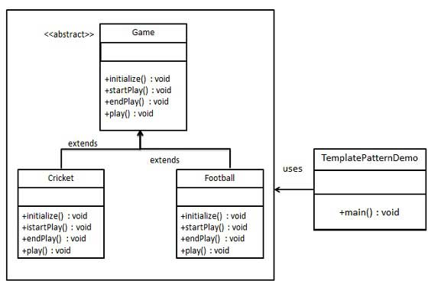
TEMPLATE PATTERN
COMPILATION
(javac.exe)
RUNTIME
Template Method is a behavioral design pattern that defines the skeleton of an algorithm in the superclass but lets subclasses override specific steps of the algorithm without changing its structure.
CONFIDENTIAL
4

Slide 29
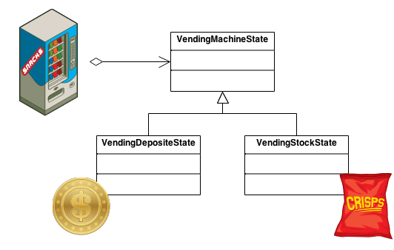
STATE PATTERN
COMPILATION
(javac.exe)
RUNTIME
State is a behavioral design pattern that lets an object alter its behavior when its internal state changes. It appears as if the object changed its class.
CONFIDENTIAL
4

Slide 30
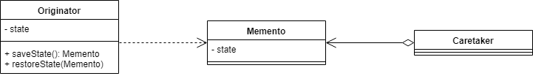
MEMENTO PATTERN
COMPILATION
(javac.exe)
RUNTIME
Memento is a behavioral design pattern that lets you save and restore the previous state of an object without revealing the details of its implementation.
CONFIDENTIAL
4

Slide 31
THANK YOU!

